Slide 1
Kernel and System Calls
(Adapted from Tannenbaum’s text)

Slide 2
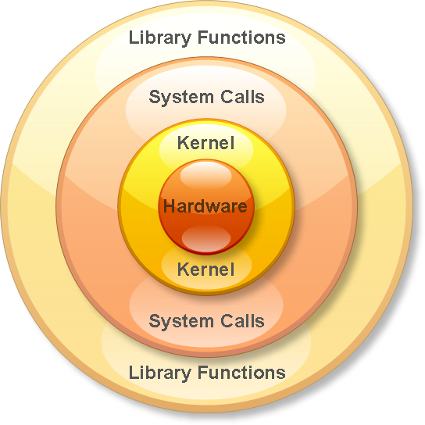
Operating System View Level

Slide 3
Kernel
Controls and mediates access to hardware.
Implements and supports fundamental abstractions:
  Processes, files, devices etc.
Schedules / allocates system resources:
  Memory, CPU, disk, descriptors, etc.
Enforces security and protection.
Responds to user requests for service (system calls)

Slide 4
Applications
System Libraries (libc)
System Call Interface
I/O Related
Process Related
Modules
File Systems
Scheduler
Networking
Memory Management
Device Drivers
IPC
Architecture-Dependent Code
Hardware

Slide 5
System Calls
System calls: The mechanism used by an application program to request service from the operating system. System calls often use a special machine code instruction which causes the processor to change mode (e.g. to "supervisor mode" or "protected mode"). This allows the OS to perform restricted actions such as accessing hardware devices or the memory management unit.
From The Free Online Dictionary of Computing (http://foldoc.doc.ic.ac.uk/) is edited by Denis Howe <dbh@doc.ic.ac.uk>.

Slide 6

Steps in Making a System Call
There are 11 steps in making the system call
read (fd, buffer, nbytes)

Slide 7
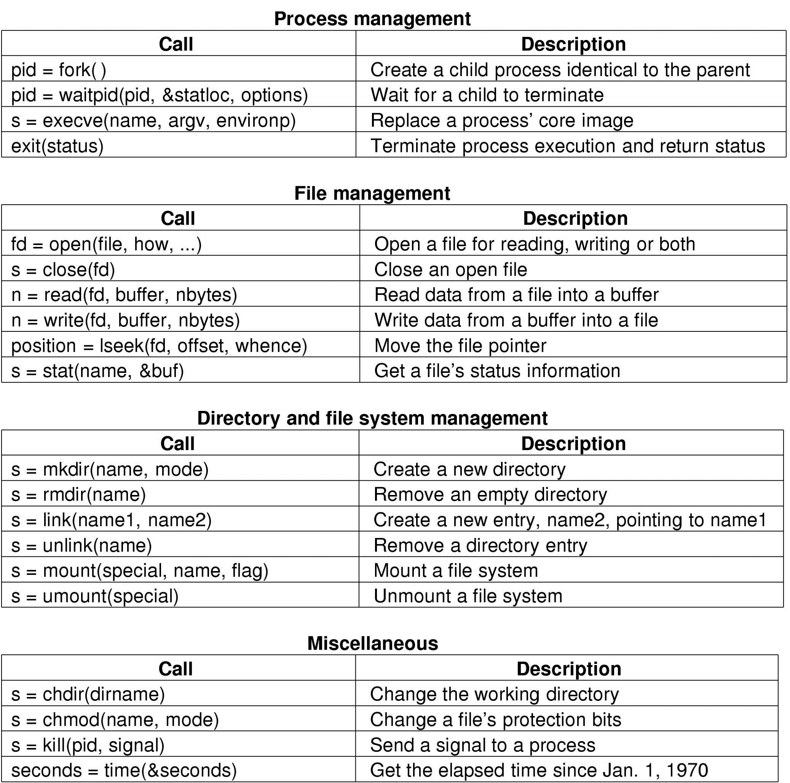
Some System Calls For Process Management

Slide 8
Some System Calls For File Management

Slide 9
Some System Calls For Directory Management

Slide 10
Some System Calls For Miscellaneous Tasks

Slide 11
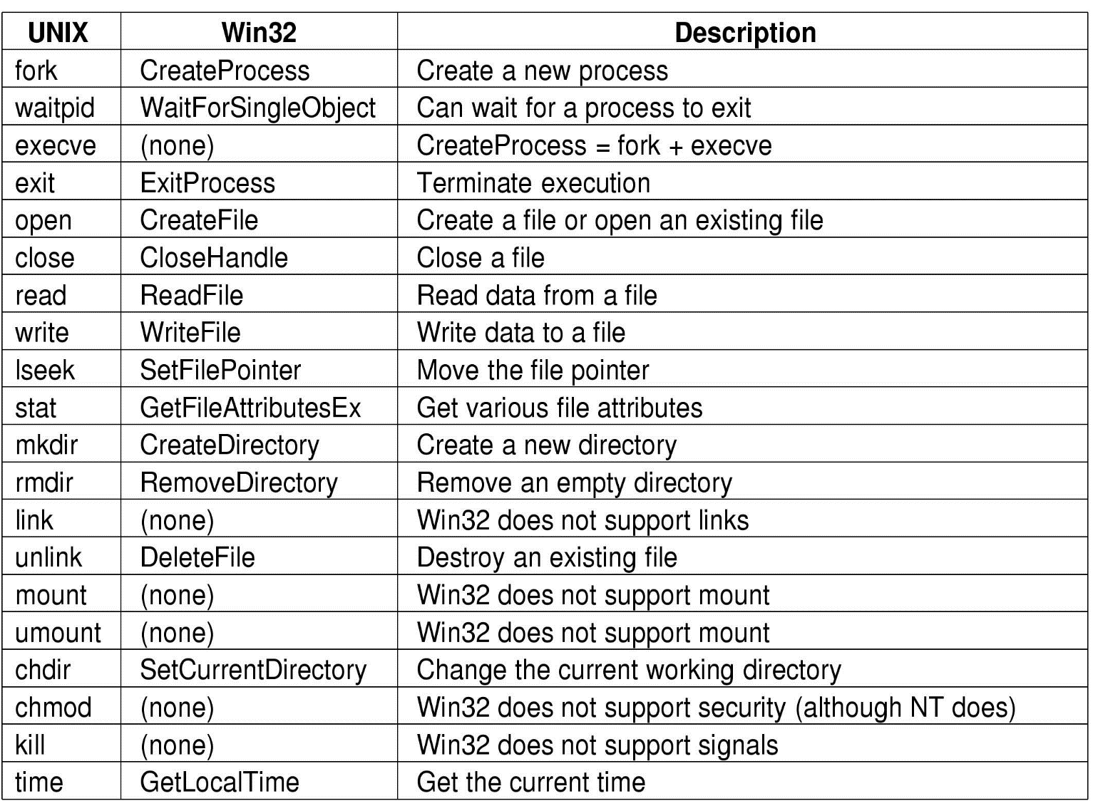
System Calls (5)
Some Win32 API calls

